Slide 1
Prepare for SQL Server and Windows Server 2008 end of support with Azure Stack

Slide 2
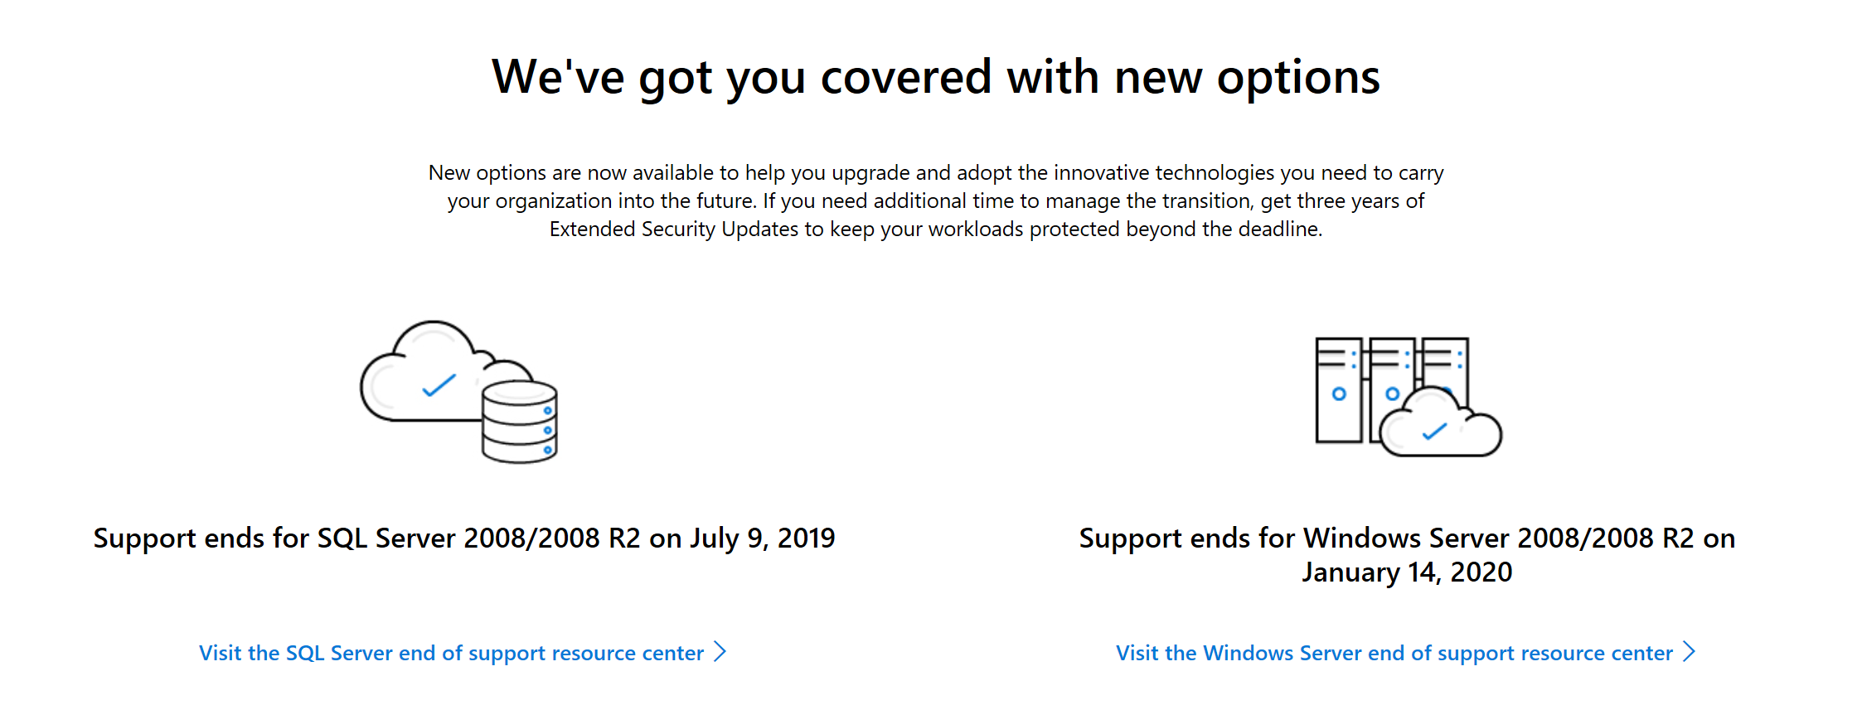

Slide 3
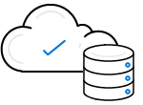
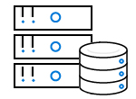
SQL Server 2008
Migrate to Azure or Azure Stack with free security updates
Rehost your SQL Server 2008 and 2008 R2 with few or no application code changes in Azure SQL Database Managed Instance for a “version-free” platform
Or, move to Azure Stack Virtual Machines to get three years of Extended Security Updates at no additional charge and upgrade to a newer version when ready
Use existing licenses and save up to 55 percent with Azure Hybrid Benefit on Azure
Upgrade on-premises and stay protected
Upgrade to SQL Server 2017 for greater security, performance, availability and innovation with cloud analytics
For continued protection beyond the deadline, buy up to three years of Extended Security Updates—cover only the workloads you need while you upgrade

Slide 4

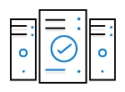
Windows 2008
Migrate to Azure or Azure Stack with free security updates
Rehost Windows Server 2008 and 2008 R2 workloads to Azure or Azure Stack
Get three years of Extended Security Updates at no additional charge, and upgrade to a current version when ready
Use existing licenses and save up to 80 percent on Azure Virtual Machines with Azure Hybrid Benefit and Reserved Instances
Upgrade on-premises and stay protected
Upgrade to Windows Server 2016 for greater innovation, built-in security, and container support
For continued protection beyond the deadline, buy up to three years of Extended Security Updates—cover only the servers you need while you upgrade

